Slide 1

STUDENT COURSE RECOMMENDATION SYSTEM
SOA Project Review-2
Date& Time
 | Under the Guidance of Mary Navyatha Govindu Assistant Professor, Department of Computer Science and Engineering, KLH CSE Bowrampet Campus
Team Members M.Vaishnavi-2420090146 V. Durga Bhavani-2420030184 P. Deva-2420030681

Slide 2
PROJECT DESIGN:
System Design
Project: Personalized Course Recommendation System
Collect student academic and preference information
Analyze student interests, skills, and academic performance
Identify suitable courses
Generate personalized course recommendations
Provide recommendations through a simple, student-friendly interface

Slide 3
System Modules
Module 1: Student Information
Academic performance
Interests
Skills
Preferences

Slide 4
Module 2: Data Analysis
Analyze student information
Identify suitable courses
Module 3: Recommendation
Generate personalized course recommendations
Match courses with student profiles
Module 4: Feedback
Collect student feedback
Improve future recommendations

Slide 5
2. Methodology Adopted
Proposed Methodology
Step 1: Student Data Collection
Collect academic and preference information
Step 2: Student Profile Analysis
Analyze interests, skills, and academic performance
Step 3: Course Matching
Compare student profile with available courses
Step 4: Recommendation Generation
Identify suitable courses
Provide personalized recommendations
Step 5: Feedback Collection
Collect student feedback
Use feedback for improving recommendations

Slide 6
Recommendation Approach
Use multiple student characteristics for personalization
Consider:
  Academic performance
  Interests
  Skills
  Preferences
Generate individualized recommendations instead of generic suggestions
Present recommendations in an understandable format
Future extension: integrate machine-learning-based recommendation techniques

Slide 7
3. Technical Soundness of the Project
Technologies & Technical Feasibility
Technologies Used
Frontend: React
Backend: Spring Boot
Database: MySQL
Recommendation/ML: Python and ML libraries
Deployment: Docker

Slide 8
Technical Feasibility
Required technologies are freely available
Each module can be developed independently
Modules can be tested separately
Technologies support development of the proposed system

Slide 9
Technical Working & Expected Outcome
Technical Working
      Student Data
      ↓
      Profile Analysis
      ↓
      Course Matching
      ↓
      Personalized Recommendation
      ↓
      Student Feedback
      ↓
      Improved Recommendation

Slide 10
Expected Outcome
Personalized course suggestions
Better matching of courses with student needs
Reduced confusion during course selection
Support for informed academic decisions
Simple and student-friendly recommendation system

Slide 11
Outline of Project Work
Focus
Introduction
Literature Survey
Challenges
Research Objectives
Conclusion & Future Work
References
Publications Details

Slide 12
Problem Statement
Choosing the right course is important for a student’s academic growth and future career.
Students often find it difficult to select courses based on their interests, skills, and academic performance.
Traditional course selection methods may provide general information without considering individual student needs.
The large number of available courses can create confusion and make decision-making difficult.
Students may also struggle to identify courses that match their career goals and preferences.
Therefore, a personalized approach is needed to support students in course selection.
The proposed system analyzes student information and identifies suitable courses.
It provides personalized course recommendations that help students make better-informed decisions.

Slide 13
Objectives
Main Objective
To develop a system that provides personalized course recommendations to students.
Specific Objectives
Collect student academic and preference information.
Analyze student interests and skills.
Identify suitable courses for each student.
Provide personalized course recommendations.
Improve the course-selection process.
Help students make informed academic decisions.
Reduce confusion while selecting courses.

Slide 14
Literature Survey
Authors | Title of the Paper | Methodology | Inferences | Limitation/Future work
Hilal et. al. [3] | Intelligent Epileptic Seizure Detection and Classification Model Using Optimal Deep Canonical Sparse Autoencoder, Biology, 2022-mdpi | Coyote optimization algorithm (COA) for feature selection Krill herd algorithm (KHA) for parameter tuning | intelligent deep canonical sparse autoencoder-based epileptic seizure detection and classification model using EEG signals. It achieves a maximum accuracy of 98.67% and 98.73% under binary and multi-classification, respectively. | The paper does not mention the specific limitations of the proposed DCSAE-ESDC technique or the experimental analysis conducted using the benchmark epileptic seizure dataset
Sanjog Ray, Anuj Sharma | A Collaborative Filtering Based Approach for Recommending Elective Courses | • Uses collaborative filtering to recommend elective courses. • Predicts the grade a student may obtain in a particular course. | • Helps students choose electives based on predicted academic performance. • Shows that collaborative filtering can be effective for course recommendation. | • Mainly focuses on predicting grades. • Does not extensively consider student interests, skills, or career goals.
Qimin Ban, Wen Wu, Wenxin Hu, Hui Lin, Wei Zheng, Liang He | Personalized Course Recommendations Based on a Learner’s Knowledge and Personality | • Uses multi-task learning. • Combines knowledge tracing, learner knowledge level, sequential behavior, and personality. • Generates personalized course recommendation lists. | • Shows that learner knowledge and personality can improve personalization. • Experimental results demonstrate improvements in HR, NDCG, and precision. | • Requires learner behavior and knowledge-related data. • The approach can be further explored for different educational environments

Slide 15
Problem Gap Identification
Identified Gaps
Existing systems may not consider multiple student factors together.
Some systems focus mainly on academic performance.
Student interests and skills may not be sufficiently considered.
Personalized recommendations can be improved.
Student feedback can be incorporated to improve future recommendations.
There is a need for a simple and student-friendly recommendation system.
Identified Research Gap
A system that combines academic performance, interests, skills, preferences, and feedback to provide personalized course recommendations can improve the course-selection process.

Slide 16
Innovation, Creativity, and Novelty
Innovation
Personalized course recommendations.
Uses multiple student characteristics.
Provides recommendations according to individual student profiles.
Creativity
Simple student-friendly interface.
Course recommendations presented in an understandable format.
Students can provide feedback on recommendations.
Novelty
Combines academic performance, interests, skills, and preferences for recommendation.
Provides individualized recommendations rather than generic course suggestions.
Can be extended with machine-learning-based recommendation techniques.

Slide 17
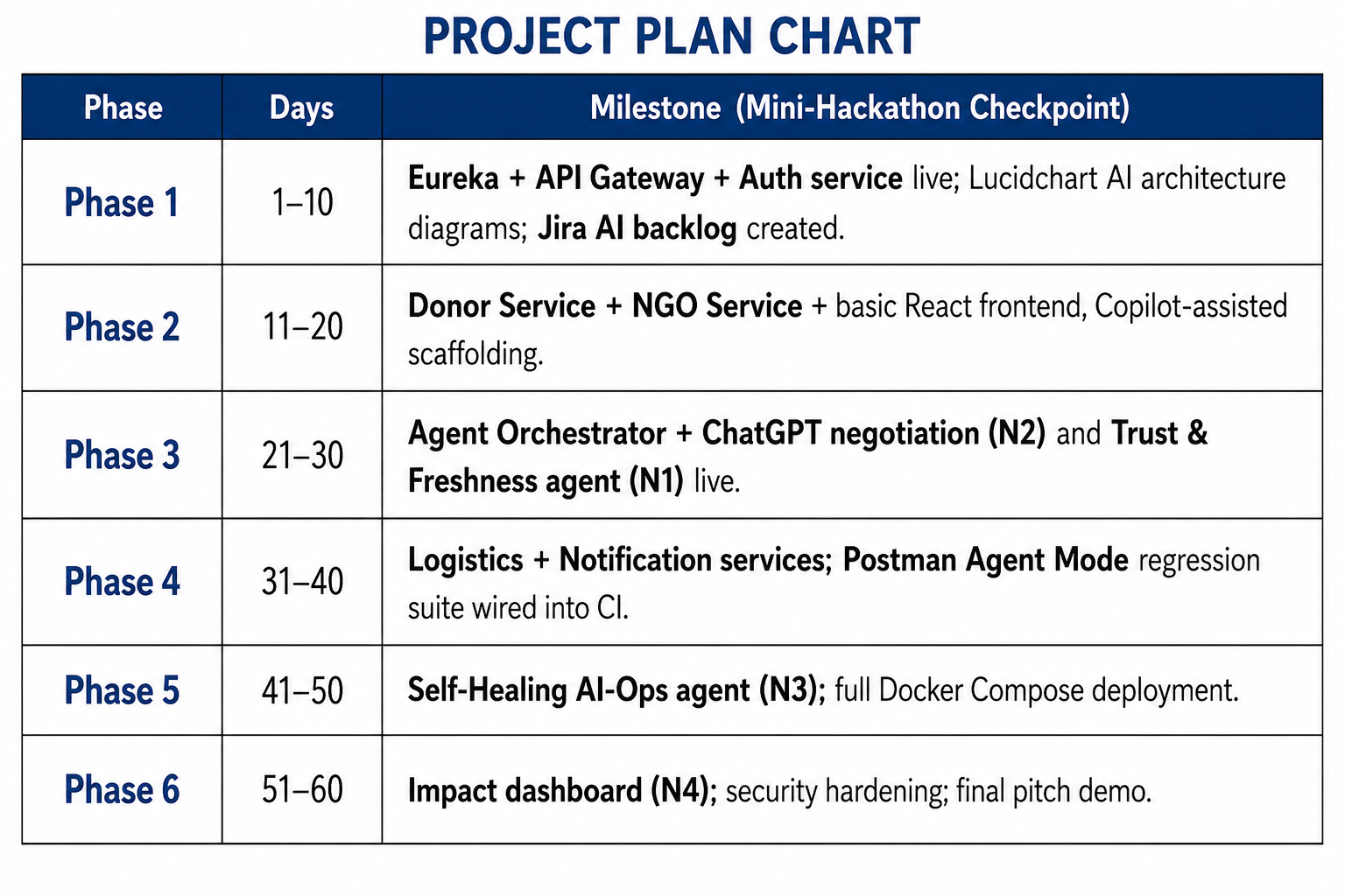
Feasibility and Project Plan
The required technologies such as React, Spring Boot, MySQL, Python/ML libraries, and Docker are freely available and support the development of the system.
The project is technically, economically, and operationally feasible, with each module developed and tested independently.

